Slide 1
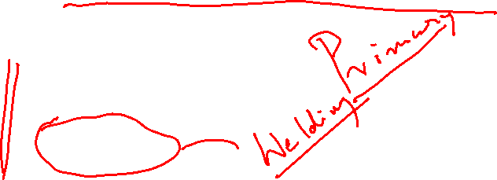
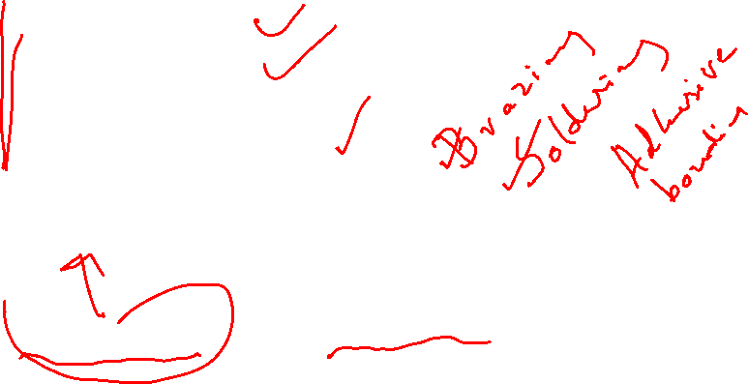
MAJOR MANUFACTURING PROCESSES
CASTING
FORMING
JOINING
SECONDARY MANUFACTURING METHODS
MACHINING AND GRINDING

Slide 2
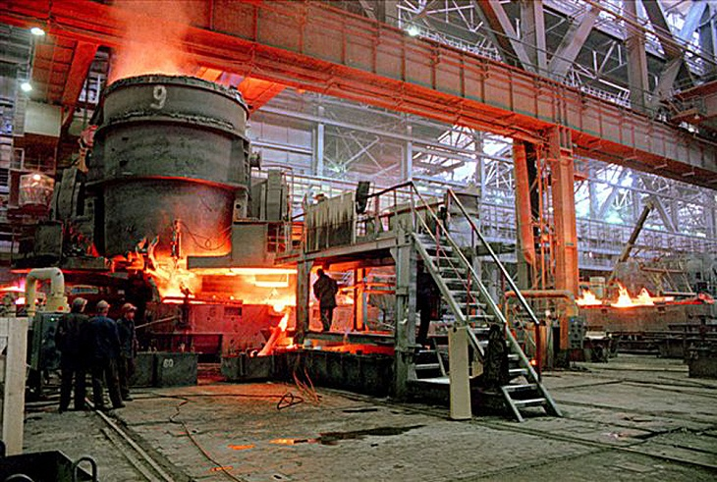
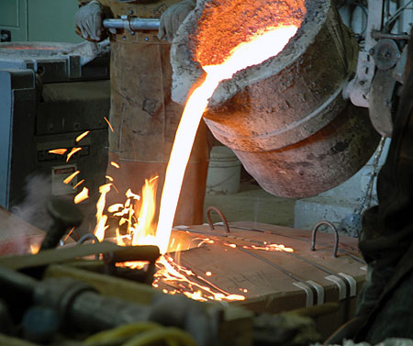
CASTING PROCESS

Slide 3
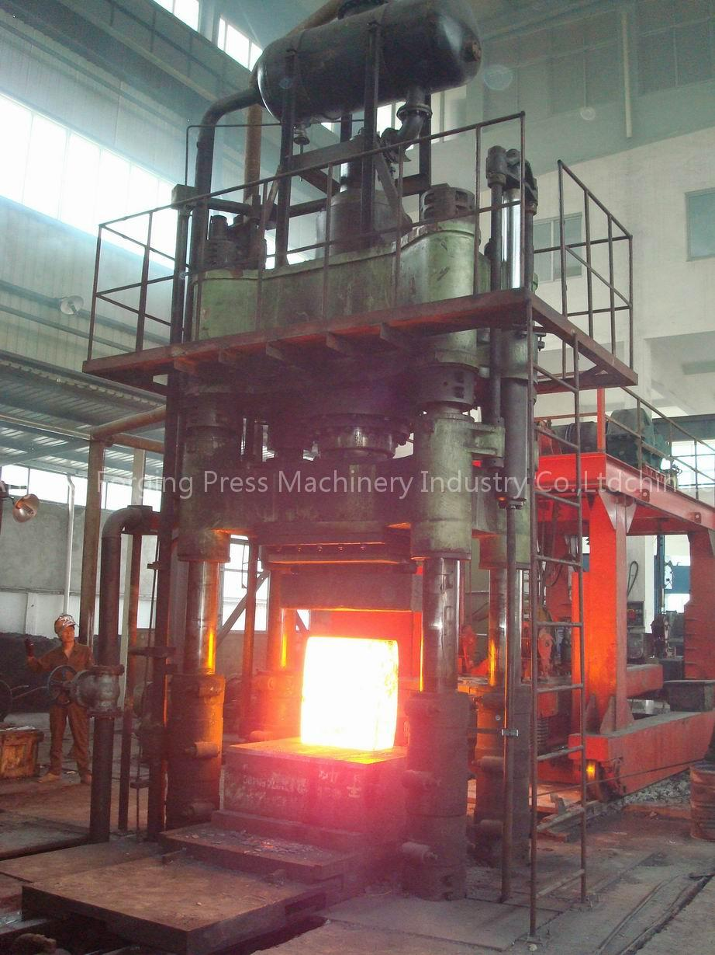
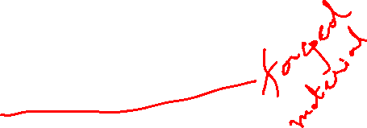
FORGING (FORMING)

Slide 4
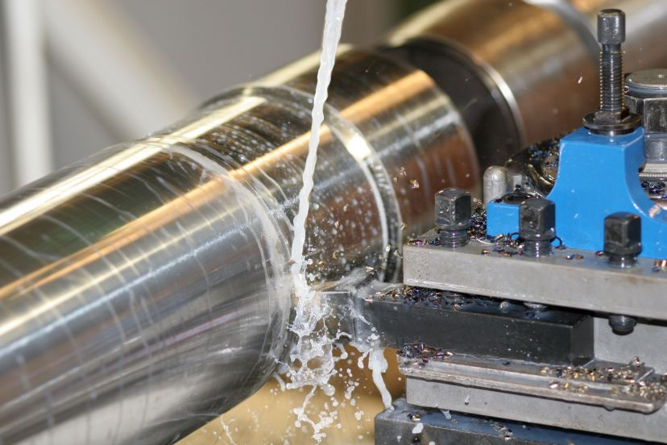

MACHINING

Slide 5
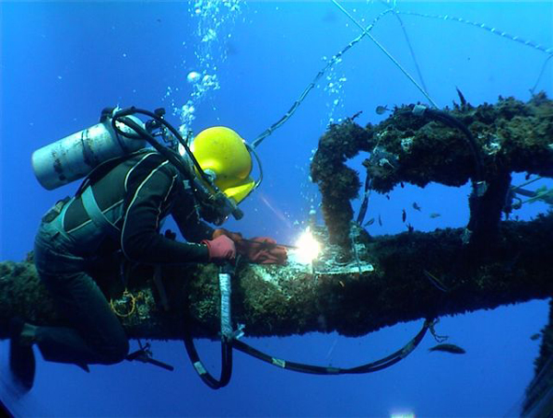
UNDERWATER WELDING

Slide 6
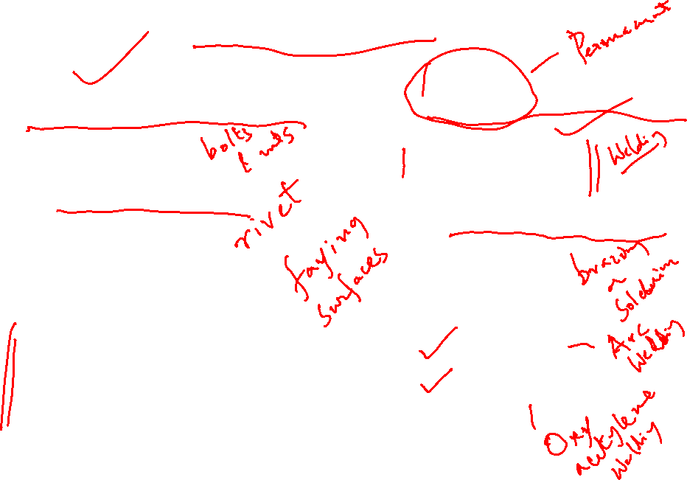
JOINING PROCESS
MECHANICAL BONDING
ATOMIC BONDING
temporary
semi permanent
solid state
liquid state
solid / liquid state
Solid state
cold welding
friction welding
diffusion welding
Liquid state
Electric
Chemical

Slide 7

Electric
Arc welding
Induction welding
Resistance welding
Chemical
Gas welding
thermit welding
Solid/liquid state
brazing
soldering

Slide 8

Welding is the joining of two or more pieces
Of metal by creating atom to atom bonds
Advantages of Welding
provides a permanent joint
welded jt. strength more than parent metal
can be accomplished on field as well
Limitations
manual and expensive in terms of labour cost
involve high energy sources
welding jt defects substantially reduce strength

Slide 9
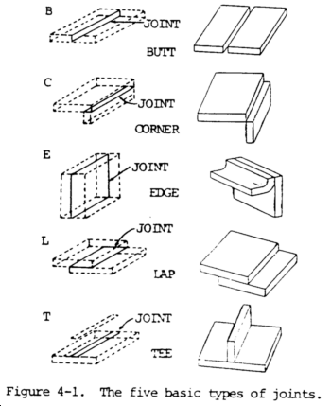

Five basic types of weld joints

Slide 10
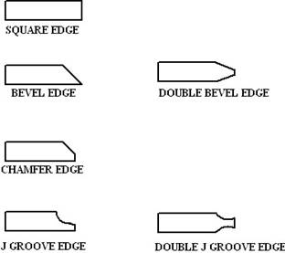

Types of edge preparations needed prior to welding
Edge prep.
needed for
Butt welding
of sheets >9 mm

Slide 11
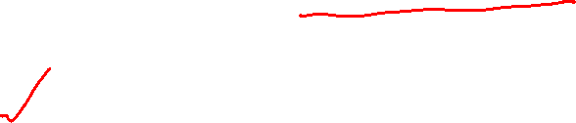
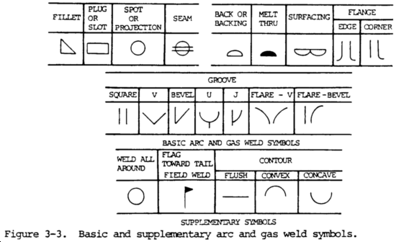
Different types of welding Symbols in use

Slide 12

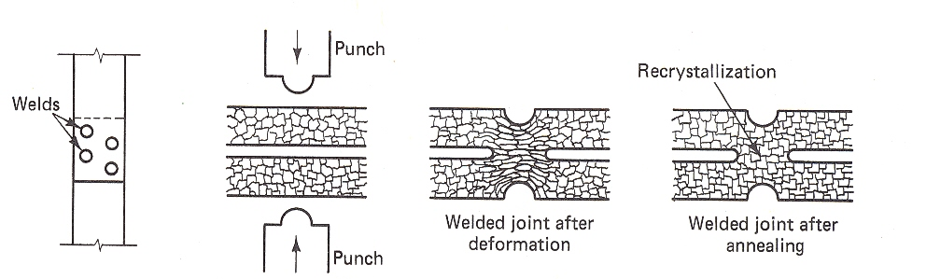
Cold pressure welding
Joining mechanism – plastic deformation
Applications – thin sheets, wires and small
electrical components
Normally accomplished by spl. Purpose machine
Effectively used for non ferrous matls especially
Al, Cu, and Al-Cu alloys
Post joining process like annealing and
machining may be required

Slide 13
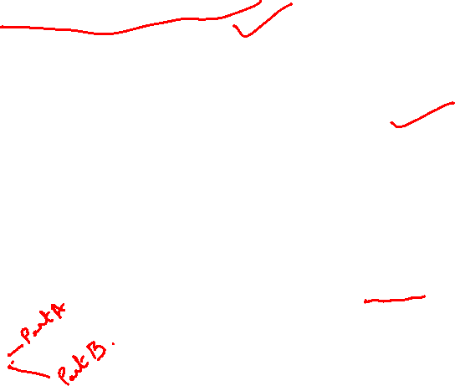

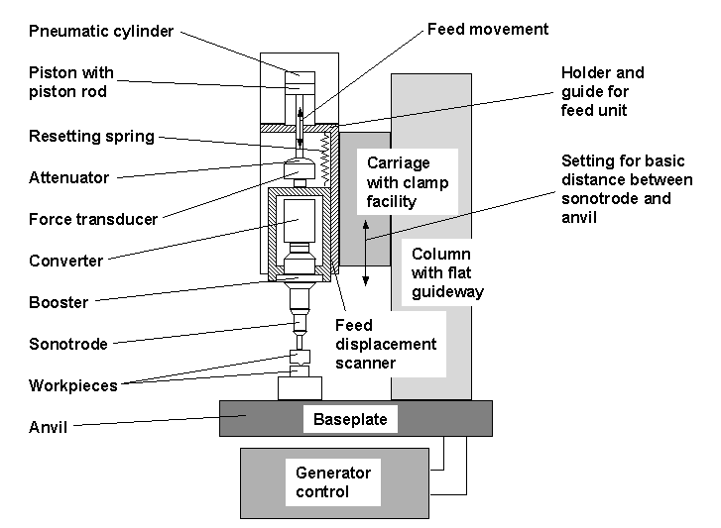
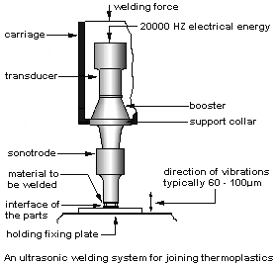
Ultrasonic Welding

Slide 14

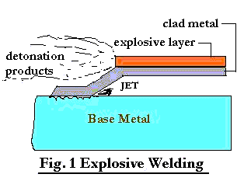
Explosive welding

Slide 15
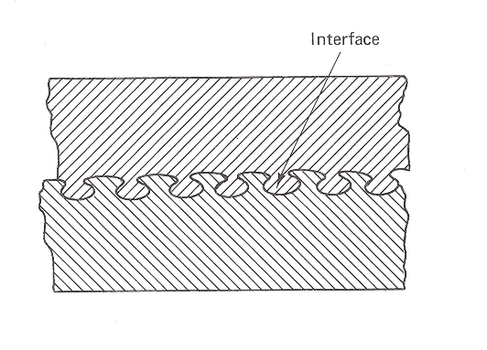

Mechanical interlocking
produced during
Explosive welding
It is popular for
Manufacturing of heat
Exchangers and
Chemical processing
Equipment
Limitation of the process is that it cannot be used
for welding hard, brittle materials

Slide 16
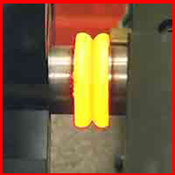

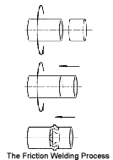
Friction Welding
Advantages
high efficiency in terms of
energy utilisation
dissimilar metals can be joined
Limitations
one of the two parts to be joined must be a body
of revolution
only forgeable materials can be friction welded

Slide 17

Diffusion Welding
Mate the surfaces intimately after cleaning
Keep them together at elevated temperature
and appropriate pressure for a long time
mechanism of joining is by diffusion
major process parameters – temp. press., time
Applications – joining of superalloys
Major Advantage – less distortion and residual
stresses
Pressure applied by dead weight, gas press.
Heating done by resistance, furnace.

Slide 18

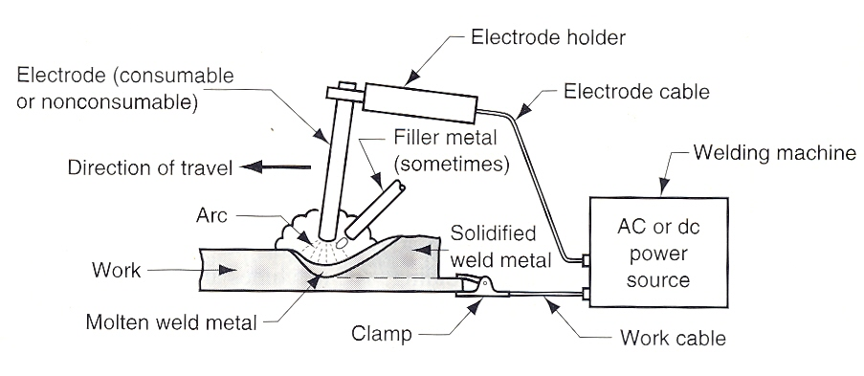
Liquid state Welding
Electric Arc Welding
Temperature at the centre of the arc 6000º C
For starting the arc 45 V for DC and upto 60 V for AC
Voltage drops to 15 to 30 V after the arc established
DCSP electrode is cathode – deposition rate high,
Heat penetration low thin sheet metals are welded

Slide 19
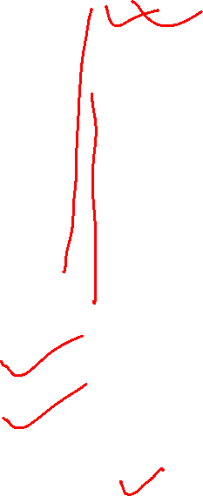
Different types of Arc Welding Processes
Shielded Metal Arc Welding (SMAW)
Submerged Arc Welding (SAW)
Gas Metal Arc Welding (GMAW)
Gas Tungsten Arc Welding (GTAW)
Plasma Arc Welding (PAW)
Carbon Arc Welding
Flux cored Arc Welding
Electrodes used in Arc Welding
Consumable
Non consumable
Consumable
Bare
coated

Slide 20
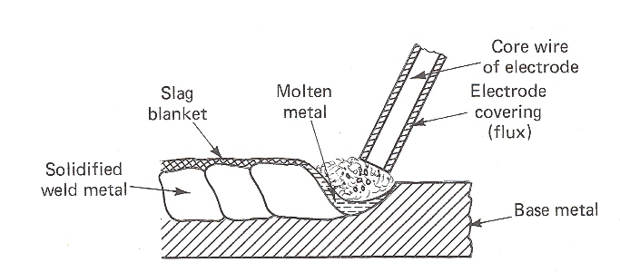

SMAW
Coated consumable electrode used
The coating melts to provide a protective
atmosphere and slag for the welding operation
Current 30 to 300 amps at 15 to 45 V
used for carbon steels, low alloy steels, CI
Advantages are better weld quality, arc stability

Slide 21

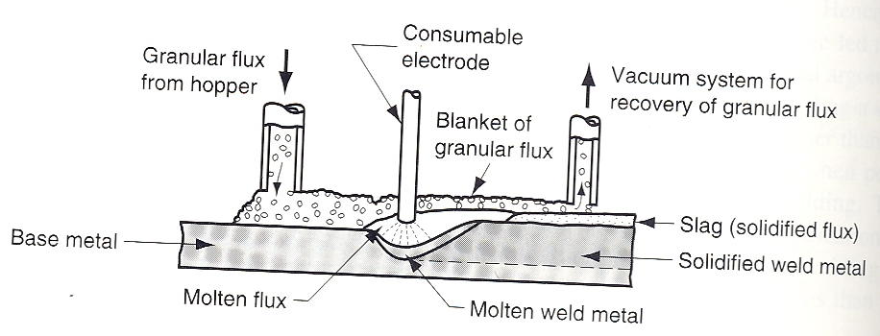
SAW
Automatic process, weld area shielded by fusible
granular flux
The flux forms a glass like slag which protects
the weld joint
Currents used 3000 to 4000 amps
high welding rate, high weld quality, deeper penet.

Slide 22
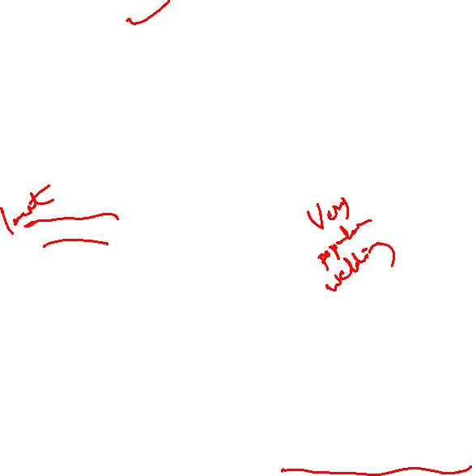
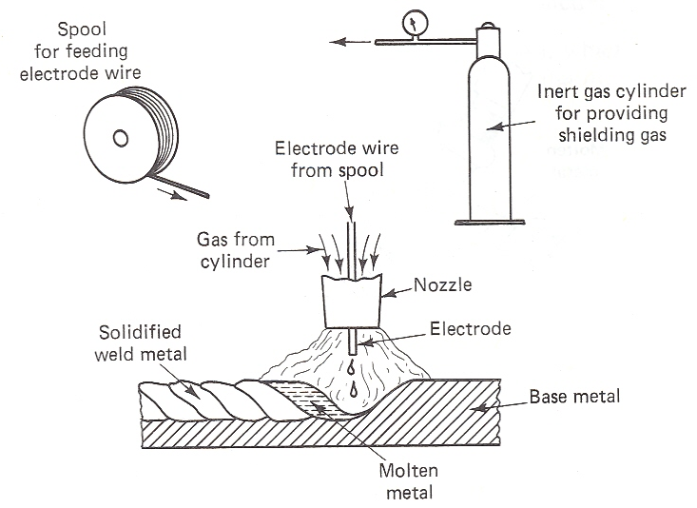
GMAW (MIG)
solid continuous consumable electrode used
Argon, He, Nitrogen, CO₂ used as shielding gas
For welding Al alloys, stainless steels, Ar/He is used
For low and medium carbon steels CO₂ is used
Process is automatic, higher depos. rate than SMAW

Slide 23

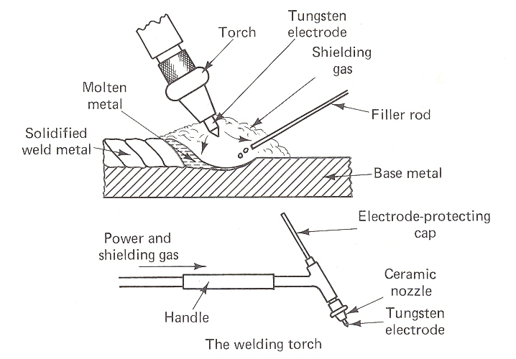
GTAW (TIG)
Non consumable electrode & inert gas for shielding
can be used to weld all types of engg. Matls.
Thin sheets of Al, Mg alloys welded by DCRP
DCSP used for steels, copper & Ni alloys
All types of joints can be produced

Slide 24

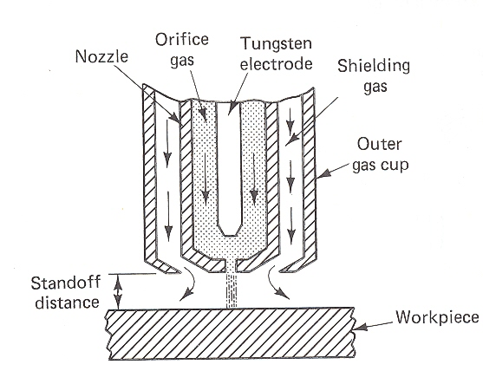
PAW
Special type of GTAW where a plasma arc is directed
at the weld area
Arc can be transferred / non transferred type
Advtgs are arc stability, better penetration control
high travel speeds, excellent weld quality
major limitation is the high equipment cost

Slide 25
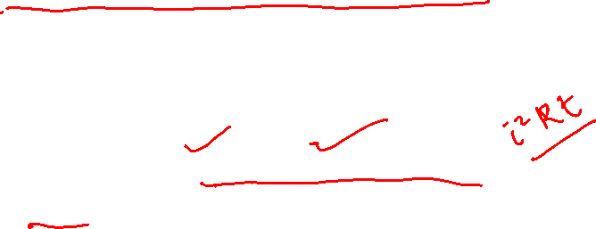
Resistance Welding Process
It is a fusion welding process that utilizes a
Combination of heat and pressure to accomplish
Coalescence.
Current used is very high 5000 to 20,000 amps,
Voltage is low (10 V), time duration is small(0.1-0.4s)
Functions of pressure ar
To ensure contact between electrodes and work
To press the surfaces when welding temp reached
Electrode materials are generally Cu or Cu alloys
Desirable properties are
high electrical conductivity
high hardness

Slide 26

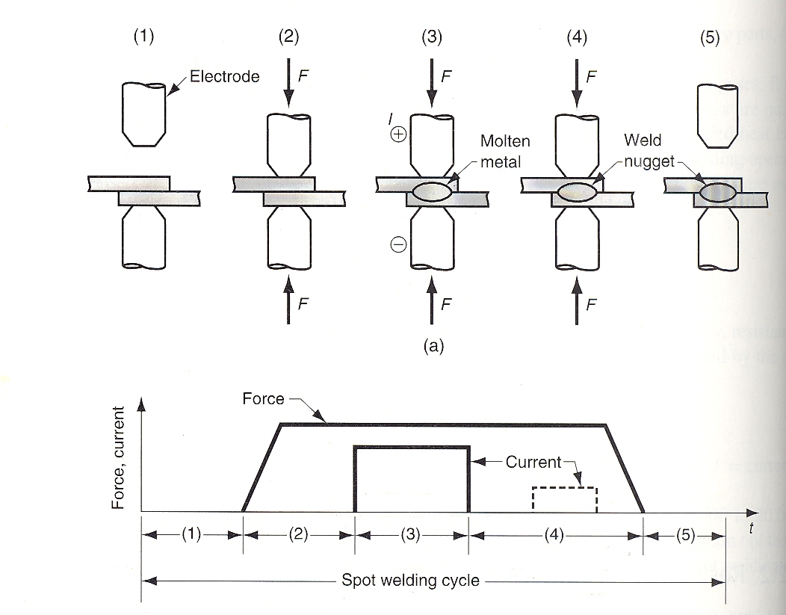
Spot Welding Process
Application of RSW
In automobile manufacturing unit
In manufacture of various appliances
In metal furniture making
Other products made out of sheet metal

Slide 27
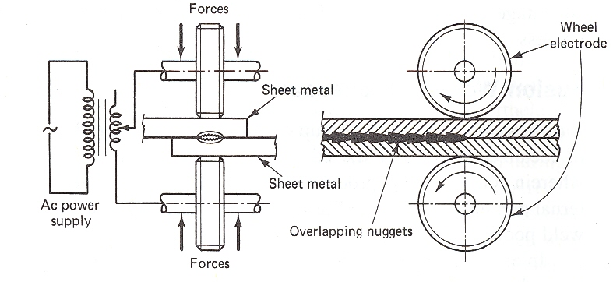
Resistance Seam Welding
Advantages
Low cost
High production rates
Suitable for automation
Limitations
Well designed fixture necessary
Sheets of thickness upto 4 mm
of carbon steel cannot be seam
welded because of the
requirement of high amperage

Slide 28
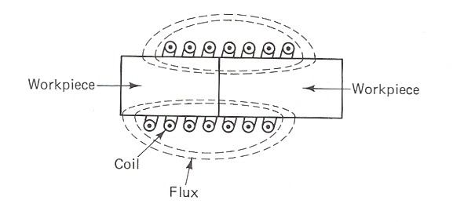
Induction
Welding
High frequency current in the range of 10 kHz to 300 kHz
The primary source of heat is the eddy current induced
into the workpiece.
An important phenomenon in induction welding is the
“skin effect”. This refers to the fact that electric current
flows superficially. The penetration can be effectively
controlled by proper choice of frequency.
Industrial application include butt welding of pipes and
continuous seam welding of tubes.

Slide 29

Gas Welding Process
Oxyacetylene flame welding
Flame temperature around 3150ºC
Neutral, reducing and oxidising flames
Reducing flame employed in welding CI
Oxidising flame employed in welding brass, bronze
The flame has three distinct zones
Inner cone having higher temp.
acetylene feather of temp around 2000ºC
Outer envelope 1250ºC

Slide 30
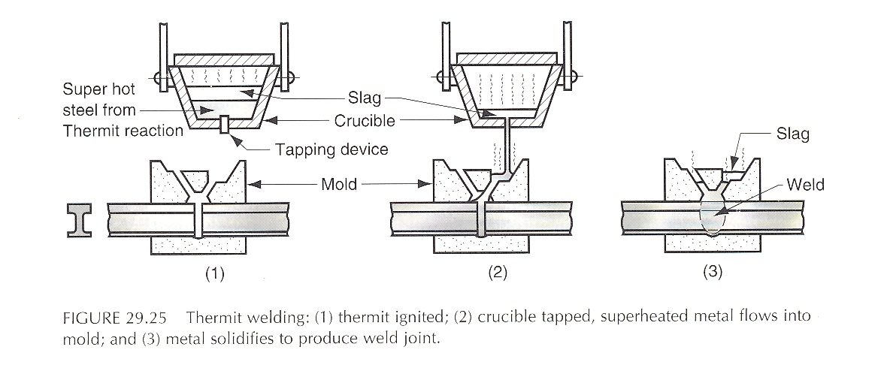

Thermit Welding
A mixture of fine alumina and iron oxide mixed
In the ratio 1:3.Temp. achievable 3000ºC
8Al+3Fe₃O₄ = 9Fe + 4Al₂O₃ + heat
Reaction time is around 30 s
It is used in joining railroad rails, pipes and in
Repairing heavy castings No finishing reqd.

Slide 31
Welding Defects
WARPAGE:
Caused due to the residual stresses in the
longitudinal as well as transverse direction of the
welded assembly
Can be minimized by
Preheating the workpiece
Proper welding fixtures
Tack welding
Proper welding conditions
Stress relief heat treatment of the welded assembly
Proper design of the weld joint

Slide 32
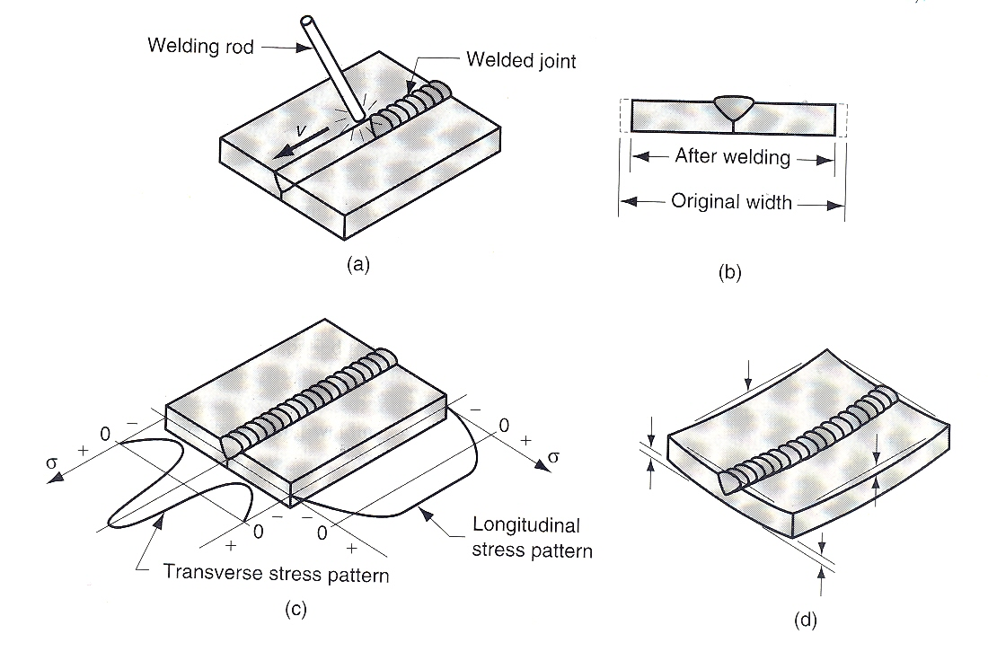
Schematic of warpage in welding

Slide 33
POROSITY:
Elongated blow holes or scattered tiny spherical holes
in the weld pool. Caused due to evolution of gases
during welding. Excess sulfur or sulfides in steel lead
to porosity. Presence of hydrogen, contaminants in
the joint and flux are other causes of porosity.
Porosity can be prevented by
Proper cleaning of the faying surfaces
Proper conditioning of the electrodes
Reducing the welding speed
Eliminating moisture on workpieces
Avoiding use of a base metal containing sulfur
or electrodes containing traces of hydrogen

Slide 34
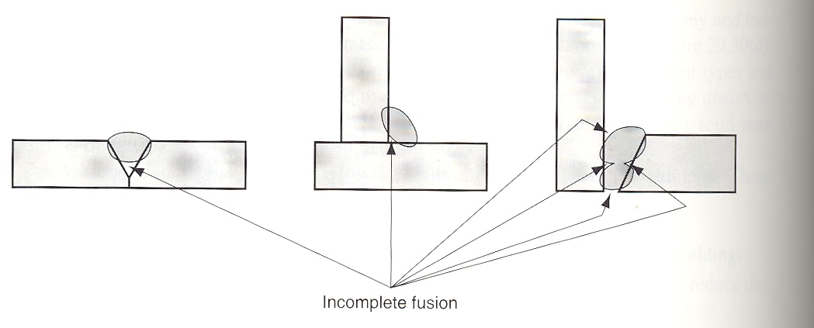
Lack of fusion
Slag inclusion
Excessive spatter

Slide 35
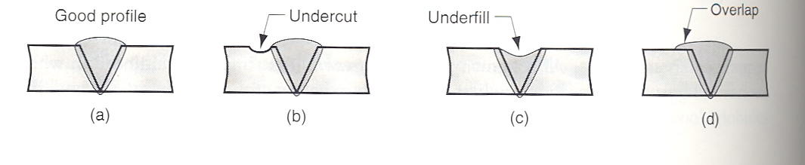
UNDERCUTTING:
Caused by excessive current in arc welding
UNDERFILLING:
Caused due to inadequate filler metal deposition
OVERLAP:
More material deposition

Slide 36
LACK OF PENETRATION:
Penetration refers to the depth that the weld extends
into the base metal of the joint. Lack of penetration
means that fusion has not penetrated deeply enough
to the root of the joint.
Causes are low energy input, wrong polarity and high
welding speed
ARC STRIKES:
Caused when the welder accidentally strikes the
electrode onto the base metal resulting in deep scar
on the part.

Slide 37
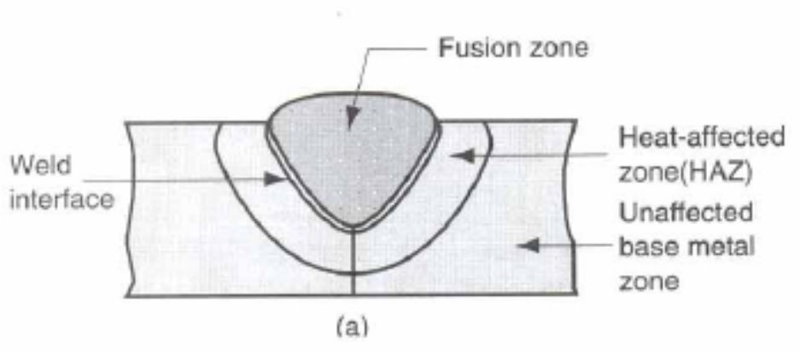
CRACKS:
Fracture type interruptions in the weld itself or in the
HAZ. Cracks developed in the weld zone is also
known as hot cracks. Such cracks occur in ferrous
alloys with high percentages of sulfur and
phosphorous and also in alloys having high
freezing range.
HAZ cracks are called cold cracks. They are formed
because of the brittleness of the HAZ. Such cracks
can be eliminated by
Avoiding hydrogen during welding
Controlling cooling rate
Employing multipass
welding technique

Slide 38
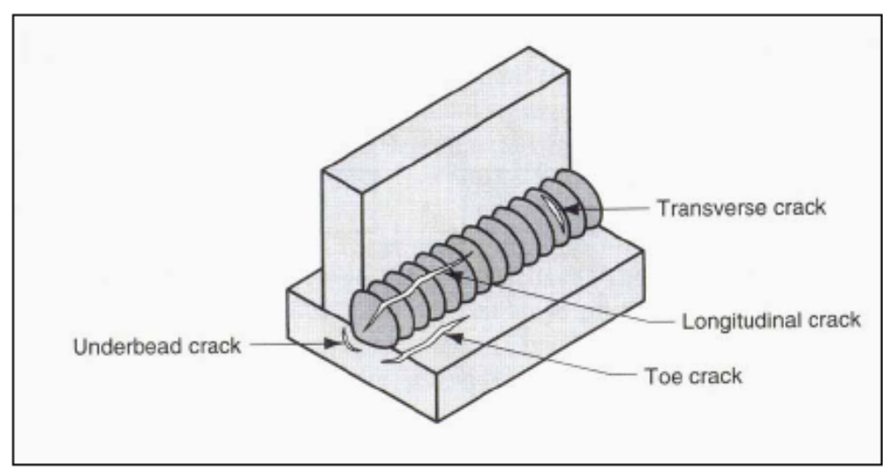
Welding Cracks

Slide 39
LAMELLAR TEARING:
A long and continuous visual separation line between
the HAZ and the base metal. It is caused by
Presence of Mn, S in the base metal
Improper weld configuration which led to
development of high residual stresses in the
transverse direction

Slide 40
BRAZING
It is a joining process in which a filler metal is melted
and distributed by capillary action between the
Faying surfaces of the metal parts being joined.
No melting of the base metals occur.
Filler metal (brazing metal) has a m.p. 450ºC but
below the m.p. of the base metal.
The clearance gap between the mating surfaces
is an imp. Parameter deciding strength of the
Joint. Clearances are small.
Use of flux like borax, fluorides, chlorides is
Essential.

Slide 41
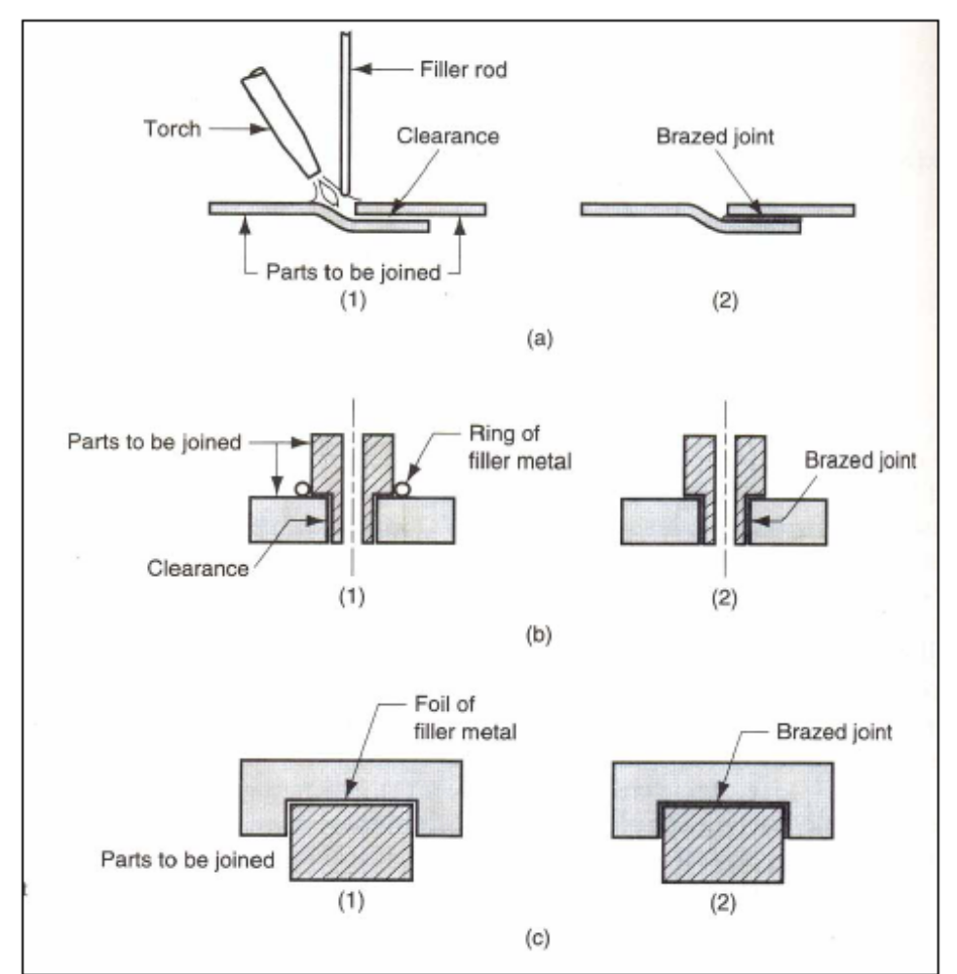
Different Brazing methods
Torch brazing
Furnace brazing
Resistance brazing

Slide 42
Advantages of brazing over welding
any metals can be joined
faster and more consistent
multiple joints can be brazed simultaneously
it can be used to join thin parts
HAZ and associated problems are eliminated
less heat and power required
Limitations of Brazing
joint strength is less
high service temperatures weaken the joint
colour of the metal at the brazed part not same
as the colour of the base metal

Slide 43
Soldering
Soldering is similar to brazing. No melting of base
Metals occur. Surfaces to be soldered must be
precleaned. An appropriate flux is applied to the
Faying surfaces and then the surfaces are heated.
The filler metal called solder is added to the joint
which distributes itself between the closely fit
Parts. The filler metal is mostly an alloy of lead tin
Having a lower strength and m.p. than base metals
Soldering is mostly carried out by electrical
Resistance heating method.

Slide 44
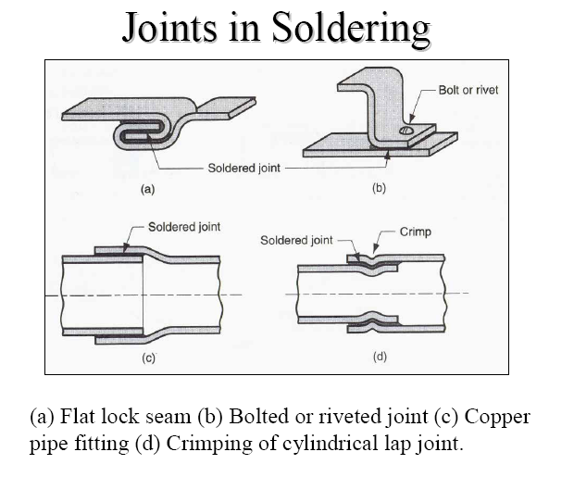

Slide 45
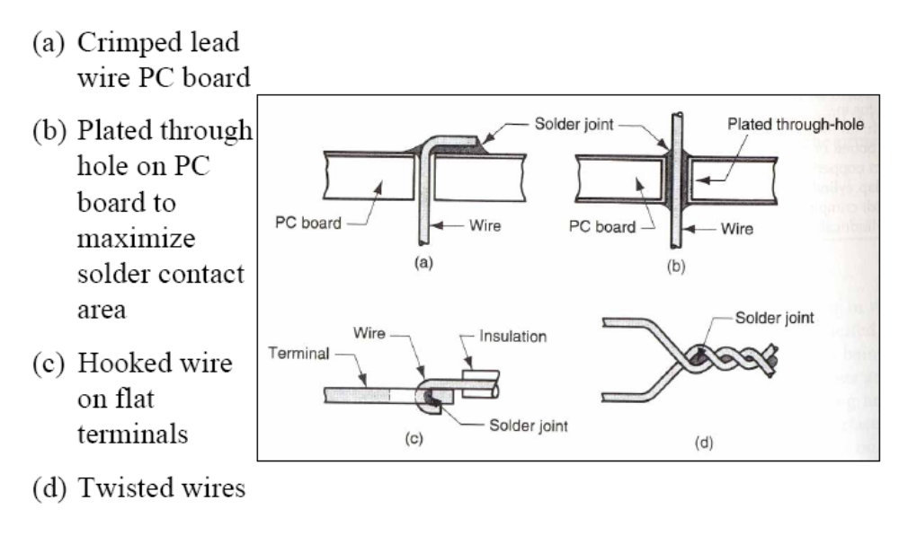

Slide 46
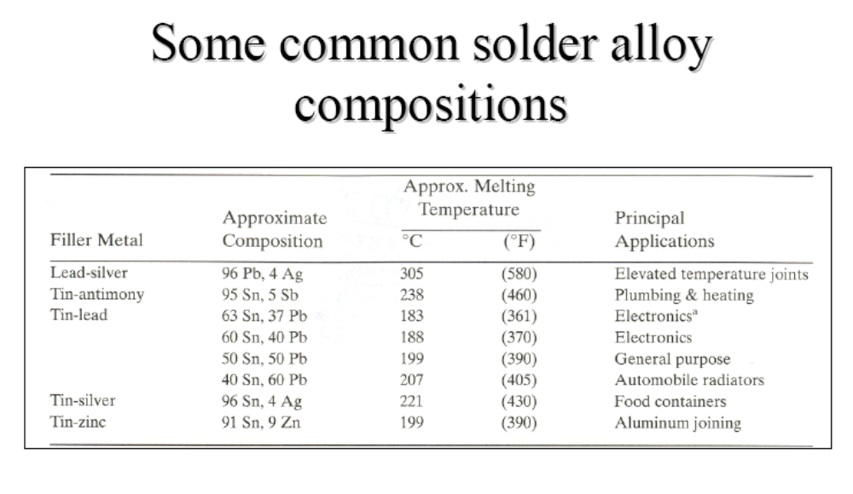

Slide 47
Advantages of Soldering
very low energy input
good electrical and thermal conductivity in the joint
air tight and liquid tight joints possible
easy to repair and rework
Limitations of Soldering
very low joint strength
possible weakening of the joint at elevated temp.

